Slide 1


Modeling and Optimization of crop production and energy generation for economic profit in an organic photovoltaics integrated greenhouse
Kensaku Okada, MS Student Agricultural and Biosystems Engineering, The University of Arizona, Tucson, Arizona, USA
Notes:
Hello everyone and thank you for coming to my defense presentation.
Today I will be talking about my graduate research “”.

Slide 2
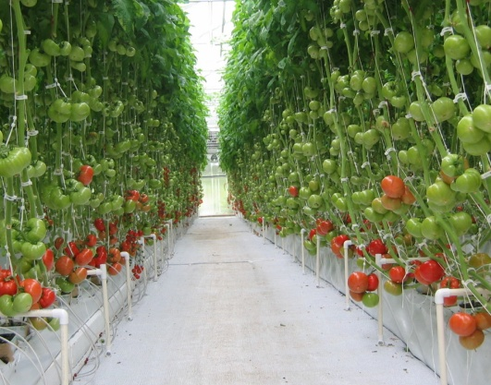
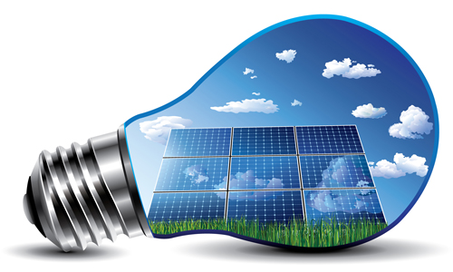
Introduction: Agrivoltaics
Creating energy while providing light for photosynthesis at the same time (make full use of light and land)
Power generation
Food production
Alleviate the competition of the land demand.
Make use of the excessive solar energy of farming for power generation (especially arid and semi-arid climates).
Notes:
I think most of you have heard of it because I did the same introduction in the graduate seminar, but let me just quickly repeat the background.
My research is about Agrivoltaics, a type of farming integrating crop and electricity production on the same land.
The main strengths of Agrivoltaics are first, we can alleviate the competition of the land demand for farming and solar power generation.
And second, you can make use of the excessive solar energy for power generation. This is especially effective in arid and semi-arid climates because the sunlight is often too strong for plants.
----------------------------------------------------------------------------------
With these strengths, it is possible to generate some electric energy not decreasing plant yield by the reduction in light intensity, and run greenhouse apart from power grid system. Therefore, it is said it can improve the profitability and sustainability of greenhouse farming.

Slide 3
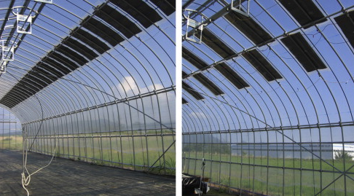
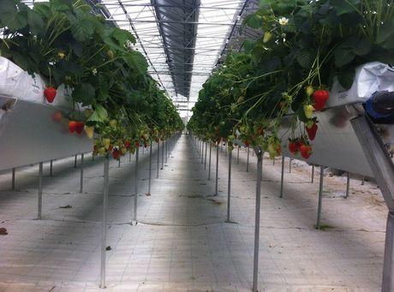
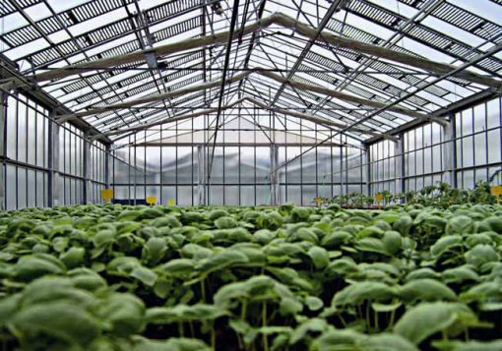
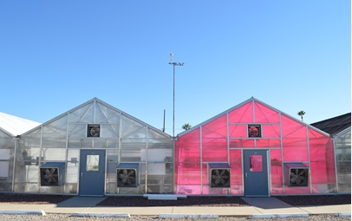
Photovoltaics(PV) integration into Greenhouse Systems
Yano et al., 2009
Società agricola M&T Green Power,
http://www.hortidaily.com
Minuto et al, 2009
Energy demand, efficiency, system component
Al-Ibrahim et al., 2006; Campiotti et al., 2008,
Vox et al., 2010; Carbone et al., 2011, Marucci et al., 2012; Juang, 2013
Kacira and Kubota, 2014
Partial shading, crop growth
Minuto et al., 2009; Dupraz et al., 2011; Carlini et al., 2012; Perez Alanso et al, 2012, Urena-Sanchez et al., 2012; Marrou et al., 2013; Li, 2014
Notes:
Here are the general images of Agrivoltaics at greenhouse. You put PV modules on the roofs and grow plants under the modules giving some shade.
-----------
The pinkish greenhouse == LSC (luminescent solar concentrator) integrated, Semitransparent PV and Energy Generating Greenhouse

Slide 4
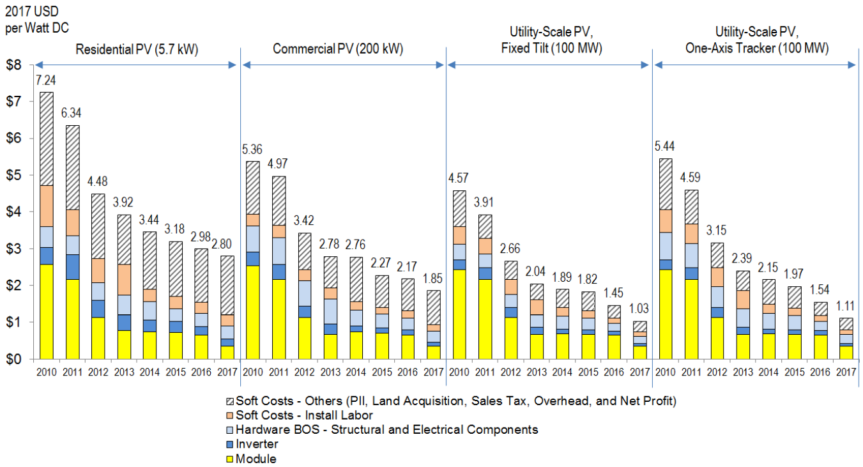
U.S. Solar Photovoltaic installation costs (USD/W)
Notes:
These graphs just show a transition of the cost for installing traditional PV module.
As you can see, the installation cost has been decreasing from 2010 to 17 at any type of scale. So it is expected Agrivoltaics will propagate more in the future.
--------------------------------------------
[Possible question]
what is the price of OPV film?
our OPV = 115W / 6m^2 and 254.03 USD/m^2
so, 254.03 * 6 / 115 = 13.25374 , which only included the module price and inverter price.
254.03 / 115 = 2.208957
The price of PV module (for residence)
2.93USD/watt, which includes all of the installation cost.

Slide 5
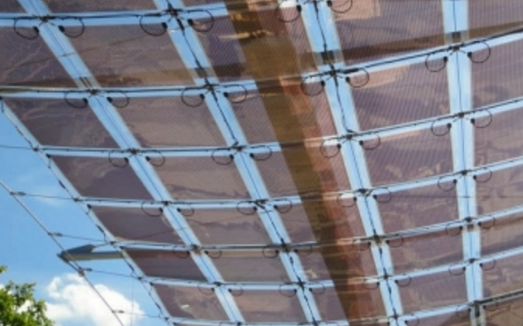
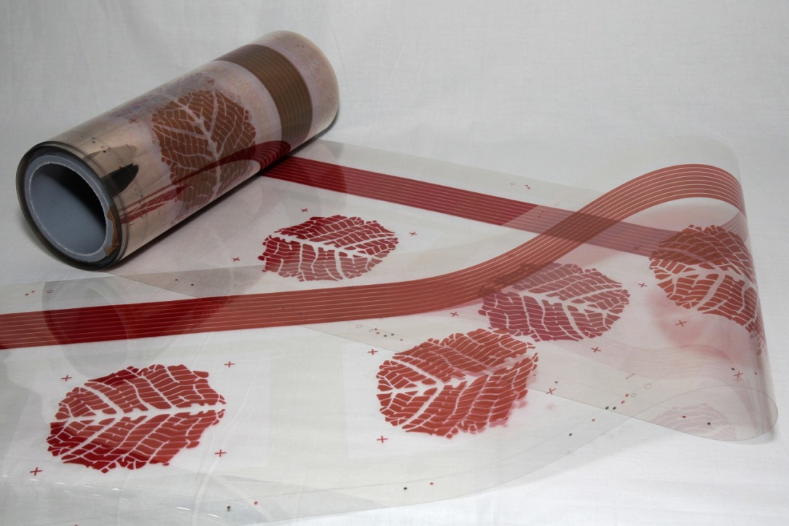
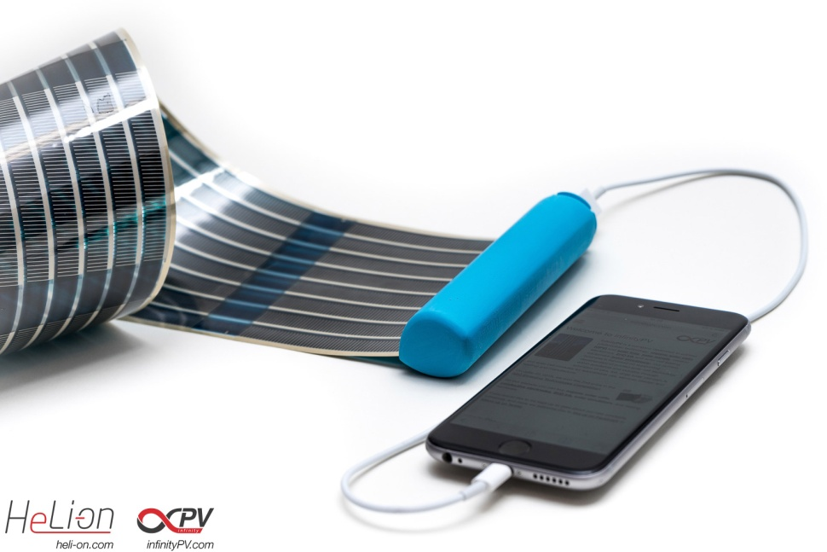
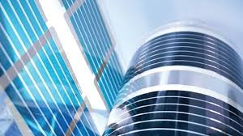
Organic Photovoltaics (OPV) film
http://www.greentechmedia.com/articles/read/Belectric-Goes-After-Building-Integrated-PV-with-Organic-Solar-Cells
http://www.vttresearch.com/media/news/decorative-and-flexible-solar-panels-become-part-of-interior-design-and-the-appearance-of-objects
http://cen.acs.org/articles/94/i18/future-low-cost-solar-cells.html
http://inhabitat.com/tag/flexible-solar-cells/
Notes:
And Now, PV technology has been developing like other technologies, and organic PV module (or OPV) is one of the new modules, which is made from organic molecules or polymers instead of inorganic materials like silicon.

Slide 6
Problem Statement: Pros and Cons of OPVs
Advantages | Disadvantages
Lower manufacturing cost Easy tunability of light absorbing spectrum color schemes and thickness Flexible (thin) | Small cell efficiency Unstable cell efficiency and (short) lifetime in real environment (almost no measurement has been conducted)
Mohammad Bagher2014, Gevorgyan et al., 2016
Notes:
Here is the list of main advantages and disadvantages of current OPV.
The Advantages are:
First, if it is made in a large quantity, the manufacturing cost can be decreased more than that of inorganic module by using a conventional printing technology.
Second, you can flexibly change many properties like shape and color because it is flexible, and you can tune the absorbed light spectrum as you like.
And the disadvantages are:
First, the cell efficiency is quite bad which is less than around 5 % at commercial scale, while the inorganic PV is usually 15 to 20%.
Second, the lifetime and the cell efficiency is unstable under a real environment. There is actually a very limited number of research about it, but according to the actual OPV I saw, it is much shorter than that of inorganic modules.

Slide 7
Project Objective
Develop an integrated model to evaluate crop production yield and energy generation in an OPV integrated greenhouse system
Optimize parameters of an OPV module and shading curtain and integrated greenhouse system (i.e. OPV coverage ratio, summer period when not growing ) to maximize economic profit
Notes:
In this way, OPV is still developing and has serious disadvantages, but it is worth researching more to put it into practical use.
So, I decided to create a simulation program which models a greenhouse farming with OPV and optimizes some parameters to maximize the economic profit.
I think this program will be a good building block for further research and for farmers to evaluate PV modules.

Slide 8
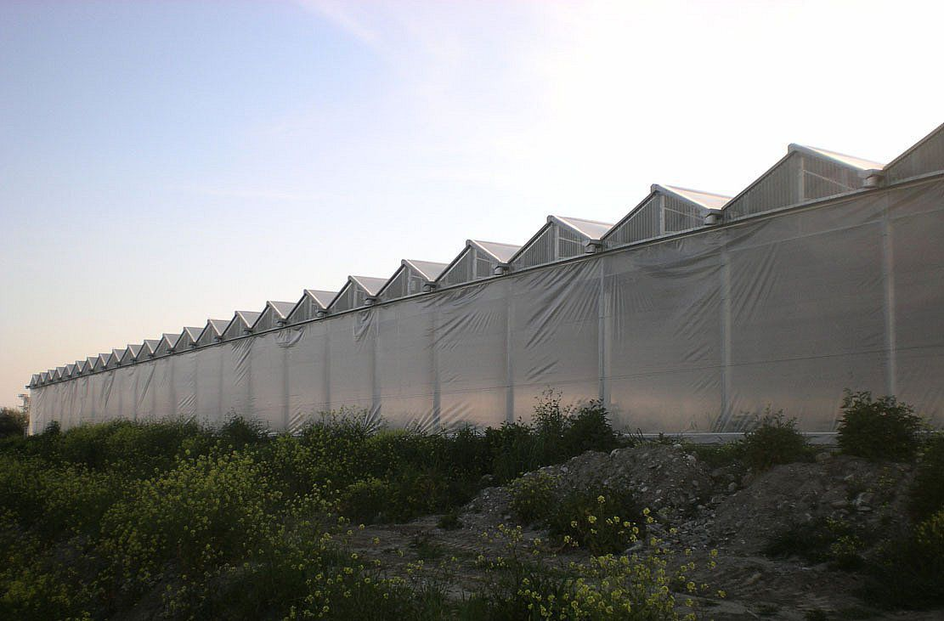
Assumed Greenhouse and Crop System Model
Gutter connected greenhouse (10 spans, 1335 m² floor)
Greenhouse orientation: North-south
Cooling with Pad & Fan, heating with natural gas
No CO₂ enrichment. Single PE film + OPV. Shading curtain. Growing lettuce
Notes:
Now, I would like to explain the model I developed.
First, I introduce the spec of the greenhouse I defined. You can change any characteristics as you like, but as an example, here is the default properties that I assumed in the simulations.
-----------------------------------------------------------------------
Average greenhouse size in the US considering GREENHOUSE VEGETABLES AND FRESH CUT HERBS is 1010 m2 based on 2012 US Census of Agriculture.
https://www.agcensus.usda.gov/Publications/2012/Full_Report/Volume_1,_Chapter_2_County_Level/Arizona/st04_2_034_036.pdf

Slide 9
Assumed OPV Material Model
4.3% cell efficiency (Lucera et al., 2017)
0.02 % overall temperature coefficient
30% visible light transmittance
Depreciation finished (both OPV and shading curtain systems have no initial cost)
Notes:
This is the spec of OPV film. Again you can configure any property, but I set these just as default values.
(read the slide aloud)
4.3% cell efficiency
0.02 % overall temperature coefficient
30% visible light transmittance
And I assumed the depreciation of OPV module and shading curtain finished to fairly evaluate these economic impact.
------------------------
The cell efficiency was cited from a literature saying that
“large area, semi-transparent organic photovoltaic modules based on industrially available materials can achieve power conversion
efﬁciencies of more than 4.8% on rigid substrates and 4.3% on ﬂexible ones.”
Source
Printed semi-transparent large area organic photovoltaic modules with power conversion efﬁciencies of close to 5 %
L. Lucera, F. Machui, H.D. Schmidt, T. Ahmad, P. Kubis, S. Strohm, J. Hepp, A. Vetter, H.-J. Egelhaaf, C.J. Brabec

Slide 10
Overall Model Flow
1. Solar irradiance to tiled PV
4. Electrical energy production
7. Electrical power sales/cost
2. Transmittance thru multi-span roof
5. Energy consumption by cooling/heating
9. Economic profit
8. Crop production sales/cost
3. Light intensity to plants thru shading curtain
6. Crop growth and yield
Notes:
Now, I would like to move on to a little detail about the sub-models in the simulator.
This is a whole picture of the program consisting of the models for (explain the flow from 1 to 9).
Since there are a lot of equations in several sub-models, I am not gonna explain all the detail, but just focus on the conceptual understanding.
Please ask me later if you get any mathematic questions.

Slide 11
Overall Model Flow
1. Solar irradiance to tiled PV
4. Electrical energy production
7. Electrical power sales/cost
2. Transmittance thru multi-span roof
5. Energy consumption by cooling/heating
9. Economic profit
8. Crop production sales/cost
3. Light intensity to plants thru shading curtain
6. Crop growth and yield
Notes:
First, I would like to explain the model for solar irradiance to tilted OPV module.

Slide 12
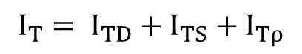
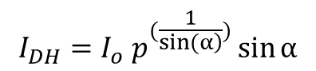
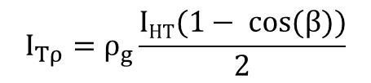
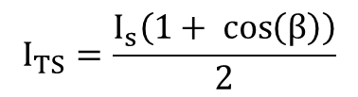
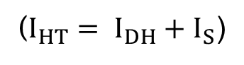
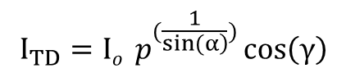
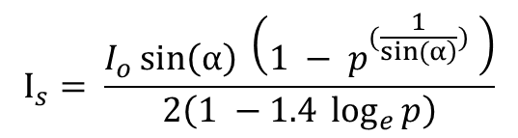
1. Model for solar radiation on tilted OPV
Estimated direct irradiance to
horizontal surface
$$I_{DH}=I_{o} p^{(\frac{1}{\left.sin(α\right)})}\sin{α}$$
Estimated diffuse irradiance to
horizontal surface
$$I_{s}= \frac{I_{o}\sin\left(α\right) \left(1 − p^{(\frac{1}{\left.sin(α\right)})} \right)}{2\left(1 −1.4 \log_{e}{p}\right)}$$
Irradiance to tilted surface
(derived from Yano et al., 2009)
$$I_{TD}=Io { p}^{(\frac{1}{\left.sin(α\right)})}\cos\left(γ\right)$$
$$I_{TS}=\frac{I_{s}\left(1+ \cos\left(β\right)\right)}{2}$$
$$I_{Tρ}=ρ_{g}\frac{IHT(1− \cos{(β)})}{2}$$
$$I_{T}= I_{TD}+I_{TS}+I_{Tρ}$$
($I_{HT}= I_{DH}+I_{S}$)
$I_{T}$[W m⁻²]: total solar irradiance to tilted surface
Notes:
This model calculated the solar irradiance to tilted surface with arbitrary direction. It can estimate the irradiance using various angles as shown in this figure. You don’t need any measured data.
And, these are the final outputs of this model.
I_{DH} is the direct irradiance to horizontal surface
I_{s} is the diffuse irradiance to horizontal surface
Using these values, it derives direct, diffuse and albedo solar irradiance to tilted surface. ( I_{TD} , I_{TS} , and I_{Ttρ})
The total solar irradiance to tiled surface was given by summing all these irradiances. This value is passed to the other sub-models as one of input variables.
-------------------------------------------------
The declination angle $δ$
n was the number of the day in the year from first January
The solar hour angle $ω$
The solar altitude angle $α$
$φ$ (rad) was the latitude of the greenhouse location
The solar azimuth angle $ψ_{s}$ (rad)
The incident angle of the beam sunlight on the module surface $γ$ (rad)
$ψ_{p}$ (rad) was the module azimuth angle, the angle between the normal to the OPV module surface and the true south
The $β$ (rad) was the tilt angle of OPV module
$θ_{Z}$ (rad) was the zenith angle, which is $(π/2− α)$ rad.
the measured diffuse radiation I_TS
ρg = ground reflectance
P = atmospheric transmissivity

Slide 13
1. Model for solar radiation on tilted OPV: Example
Notes:
This is a typical estimated solar irradiance on a tilted surface.
Blue line: direct solar irradiance to the east facing roof
Orange line: direct solar irradiance to the west facing roof
The total solar irradiance was calculated by summing the mean of each direct solar irradiance, diffuse irradiance and albedo irradiance.

Slide 14
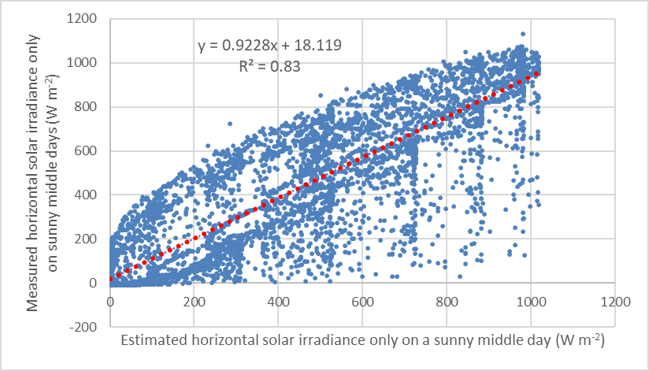
1. Model for solar radiation on tilted OPV: Validation result
Correlation of estimated vs real solar irradiance to horizontal surface
Notes:
This is a validation result of the model. This figure compares the measured and estimated solar irradiance to a horizontal surface.
Since the real data is affected by weather change, there are some outliers, but it predicted the irradiance pretty reasonably.
------------------------------------------------------

Slide 15
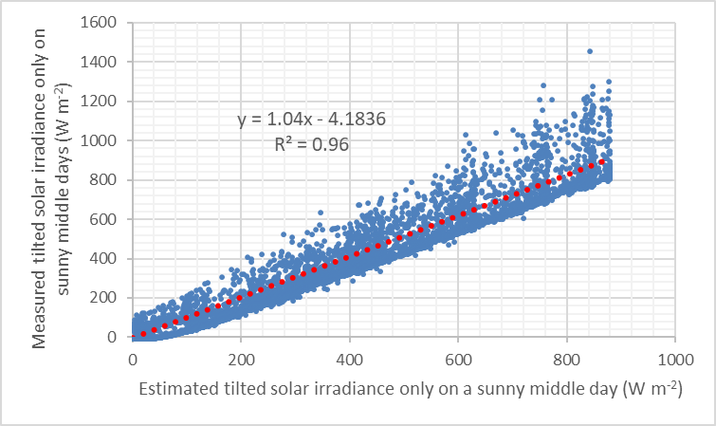
1. Model for solar radiation on tilted OPV: Validation result
Correlation of estimated vs real solar irradiance to tilted surface
Notes:
And this figure compares the measured and estimated solar irradiance to a tilted surface.
Interestingly, we observed a larger correlation for the irradiance to a tilted surface. So we can say the model is validated enough.
------------------------------------------------------
The measured solar irradiance to a tilted surface was estimated using the equations on page 11.

Slide 16
Overall Model Flow
1. Solar irradiance to tiled PV
4. Electrical energy production
7. Electrical power sales/cost
2. Transmittance thru multi-span roof
5. Energy consumption by cooling/heating
9. Economic profit
8. Crop production sales/cost
3. Light intensity to plants thru shading curtain
6. Crop growth and yield
Notes:
Next, I would like to explain Model 4. and 7.

Slide 17
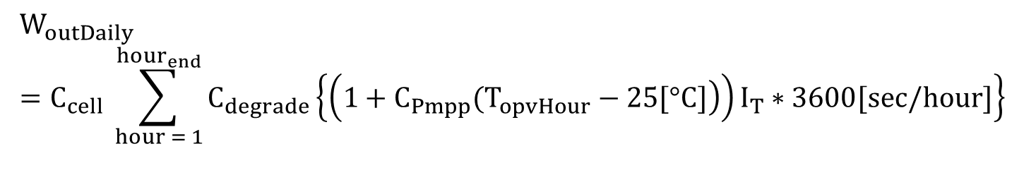
4. Model for electricity production by OPV film
$$W_{outDaily}=C_{cell} \sum_{hour = 1}^{{hour}_{end}}{C_{degrade}\left\{\left(\left.1+C_{Pmpp}(T_{opvHour}−25[°C]\right)\right)I_{T}∗3600[sec/hour]\right\}}$$
C_{cell}: cell efficiency [-]
C_{degrade}: degradation ratio of PV [-] : assumed 20 * 0.008 hour⁻¹
C_{pmpp}: temperature coefficient for power [-℃⁻¹]: assumed 0.0002 from our OPV module
T_{opvHour} [℃]: OPV temperature: assumed same as the weather station’s measurement device body temperature
I_{T} [W m⁻²]: total solar radiation to the PV module
Notes:
The produced electricity for the whole simulation period (1 year) was simply calculated by this equation.
It considers cell efficiency, degradation ratio, temperature coefficient, and the temperature of the OPV module which were assumed to be same as the weather station’s measurement device body temperature.
I_{T} ,the total solar irradiance to the module, was taken from the last model.
-----------------------------------------------------------------------------------------
H = direct solar radiation
H_d = diffuse solar radiation
H_d,p = albedo solar radiation (the ground reflected radiation)
H_T = total solar radiation
-----------------------------------------------------------------------------------------
This slide shows the equations calculating the electricity yield and light intensity to plants in the greenhouse.
The first equation uses the total solar radiation to the tilted surface, that is H_T in the last slide, and the second part uses the radiation to horizontal surface.
The rest of the part considers the transmittance of OPV film, plastic covering, greenhouse structures, and shading curtain. Finally, it convers its unit from PPFD to DLI.

Slide 18
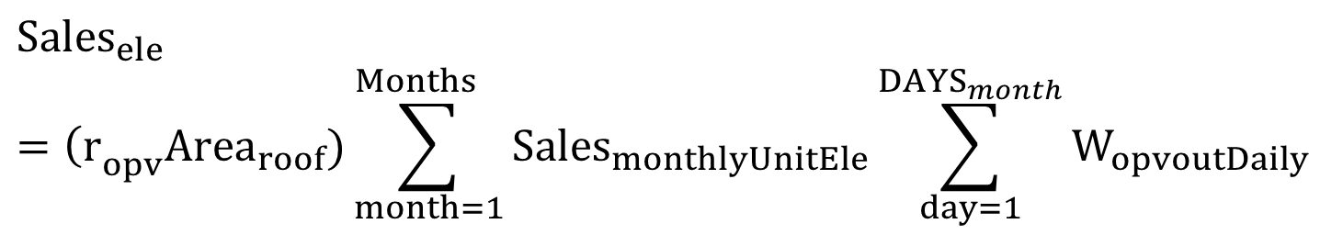
7. Model for electrical power sales
$${Sales}_{ele}={\left(r\right.}_{opv}{Area}_{roof})\sum_{month=1}^{{Months}_{}}{{Sales}_{monthlyUnitEle}}\sum_{day=1}^{{DAYS}_{month}}{W_{opvoutDaily}}$$
r_{opv} [-]: PV module ratio on greenhouse roof (100: fully covered, 0: not PV)
Area_{roof} [m²]: greenhouse roof area (1660.3)
Sales_{monthlyUnitEle} [USD kwh⁻¹]: electricity sales price on each month (10.99 - 12.78)
W_{opvoutDaily} [kwh m⁻² day⁻¹]: electric energy made by PV module each day
Notes:
This is the equation for electricity sales price.
With the generated electricity calculated in the last equation, and OPV area and the sales price of electricity, it gives the total sales price

Slide 19
Overall Model Flow
1. Solar irradiance to tiled PV
4. Electrical energy production
7. Electrical power sales/cost
2. Transmittance thru multi-span roof
5. Energy consumption by cooling/heating
9. Economic profit
8. Crop production sales/cost
3. Light intensity to plants thru shading curtain
6. Crop growth and yield
Notes:
The next sub-model is the transmittance through multi-span roof

Slide 20
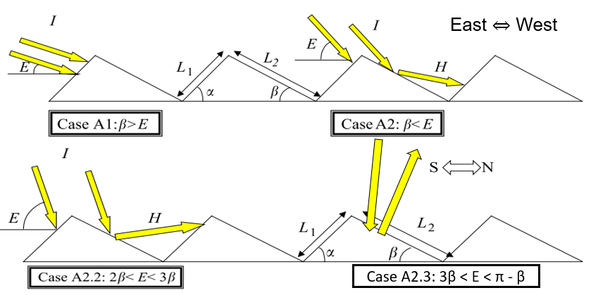
3. Model for the solar transmittance of multi-span greenhouse
β = the roof angle. α = β in this study (symmetric roof)
E = angle formed by the incident ray with the horizontal axis
Notes:
The equations were classified into four cases by the relationship between the roof angle (β or α) and the angle formed by the incident solar ray with the horizontal axis (E).
Each case has different equations to calculate the transmittance depending on the existence of the reflectance between roofs.

Slide 21
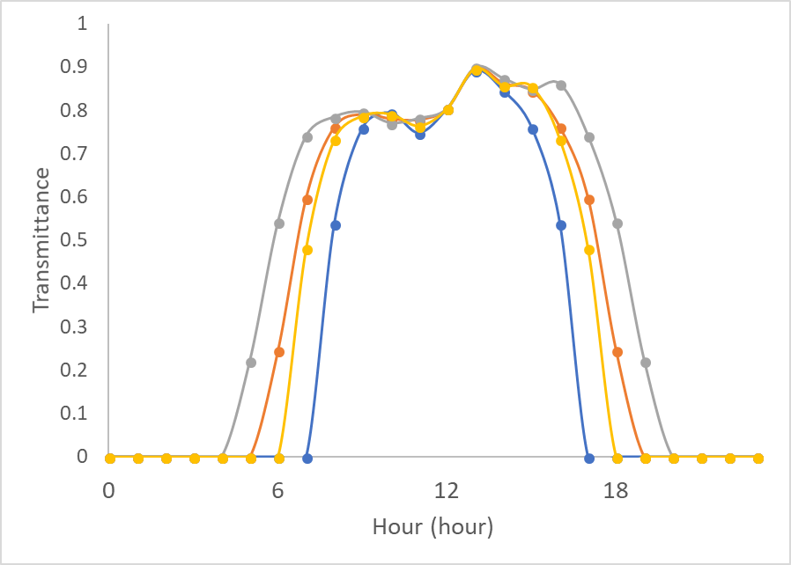
3. Model for the solar transmittance of multi-span greenhouse
Transmittance through multi-span roof on January (blue), April (orange), July (gray), and October (yellow) 1st.
Notes:
This is part of the result of this model, which shows the transition of transmittance on January 1st (the blue line), April 1st (the orange line), July 1st (the gray line) and October 1st (the yellow line).
Since the model estimated the transmittance only when there is sunlight, the transmittance at night time was zero,.
And since I assumed the covering material was single PE film whose transmittance was around 80 to 85%, the model predicted the reasonable number.

Slide 22
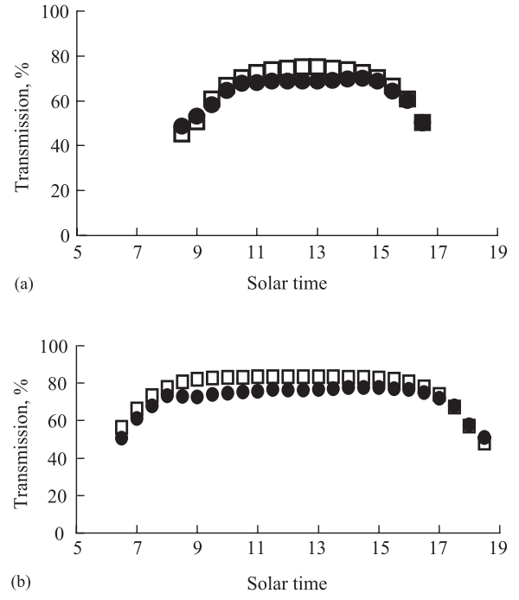
3. Model for the solar transmittance of multi-span greenhouse
Jan 13 (winter)
□ : simulated val
● : measured val
Jun 19 (summer)
Notes:
And the shape of the curve was justified by comparing with the literature of the model, and these figures were cited from it.
You can see the transmittance during daytime was kind a flat and had smaller values soon after the sunrise and before the sunset, and my result also showed the same transition.
So we can say this model estimation is acceptable.
---------------------------------------------------------------------------
East–west oriented 1:15 greenhouse models at the
experimental site (latitude 378 10N), south of Spain, with the
south-facing and north-facing slopes shown for each model
The cover glass was 8 mm thick

Slide 23
Overall Model Flow
1. Solar irradiance to tiled PV
4. Electrical energy production
7. Electrical power sales/cost
2. Transmittance thru multi-span roof
5. Energy consumption by cooling/heating
9. Economic profit
8. Crop production sales/cost
3. Light intensity to plants thru shading curtain
6. Crop growth and yield
Notes:
The next model is about Light intensity to plants thru shading curtain

Slide 24
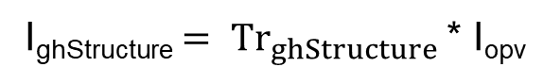
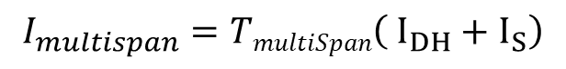
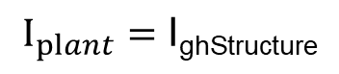
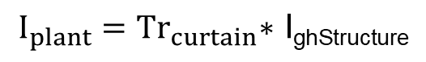
4. Model for light intensity to plants
From Model 2. Transmittance thru multi-span roof
$$I_{multispan}=TmultiSpan\left( I_{DH}+I_{S}\right)$$
From Model 1. Solar irradiance to tiled PV
$$I_{opv}={ Tr}_{opv}\left\{\left(r_{opv}){ I}_{multispan}+ \left(1−r_{opv}\right)I_{multispan}\right.\right\}$$
I_{ghStructure}$= {Tr}_{ghStructure}$ * I_{opv}
(If the simulation date is during the period when deploying shading curtain)
$$I_{plant}={Tr}_{curtain}\text{∗ }\text{I}\text{ghStructure}$$
(Else if the simulation date is out of the period when deploying shading curtain)
$$I_{plant}=\text{I}\text{ghStructure}$$
Shading curtain deployment strategy: dynamically changed the closing hour
each month based on the average DLI, aiming as close as 17 mol m⁻² day⁻¹
Notes:
This model considered several factors reducing the solar irradiance until the light reaches the lettuce.
The considered factors were OPV module, the greenhouse structures including fans, gutters and so on, and shading curtain.
The time of shading curtain deployment was calculated according to the total solar irradiance on each month so that the average DLI becomes less than or equal to 17.
So you can imagine the shading curtain was almost not used during winter season and used more frequently in summer, which highly led equalizing solar irradiance inside greenhouse.

Slide 25
Overall Model Flow
1. Solar irradiance to tiled PV
4. Electrical energy production
7. Electrical power sales/cost
2. Transmittance thru multi-span roof
5. Energy consumption by cooling/heating
9. Economic profit
8. Crop production sales/cost
3. Light intensity to plants thru shading curtain
6. Crop growth and yield
Notes:
The next model is about lettuce growth and yield.

Slide 26
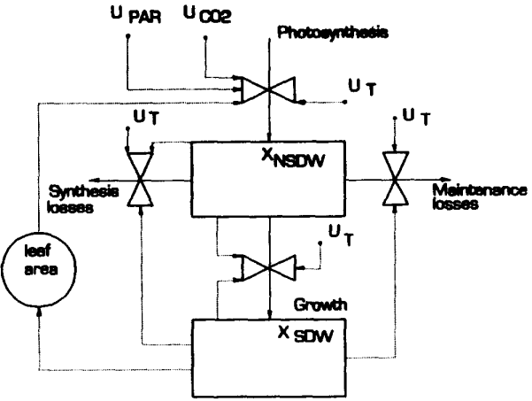
6. Model for crop growth
U_{PAR}: photosynthetic active radiation, U_{t}: canopy temperature, U_{CO2}: carbon dioxide concentration in greenhouse air, X_{NSDW}: non-structured dry weight, X_{SDW}: structured dry weight
Notes:
This is the schematic of the crop growth model. It required CO2 concentration, solar irradiance as Photosynthetic Active Radiation and the greenhouse temperature as input variables.
CO2 concentration was assumed to be 400 ppm all the time, and the greenhouse house temperature was 24 ℃ degrees at daytime and 19 ℃ degrees at night.
-------------------------------------------------------------------------------
X_{NSDW}: non-structured dry weight,
X_{SDW}: structured dry weight
The non structural dry weight is consists of glucose sucrose and starch.
the structural dry weight is the remaining component of the total dry weight and represents the weight of structural components like cell walls and cytoplasm.

Slide 27
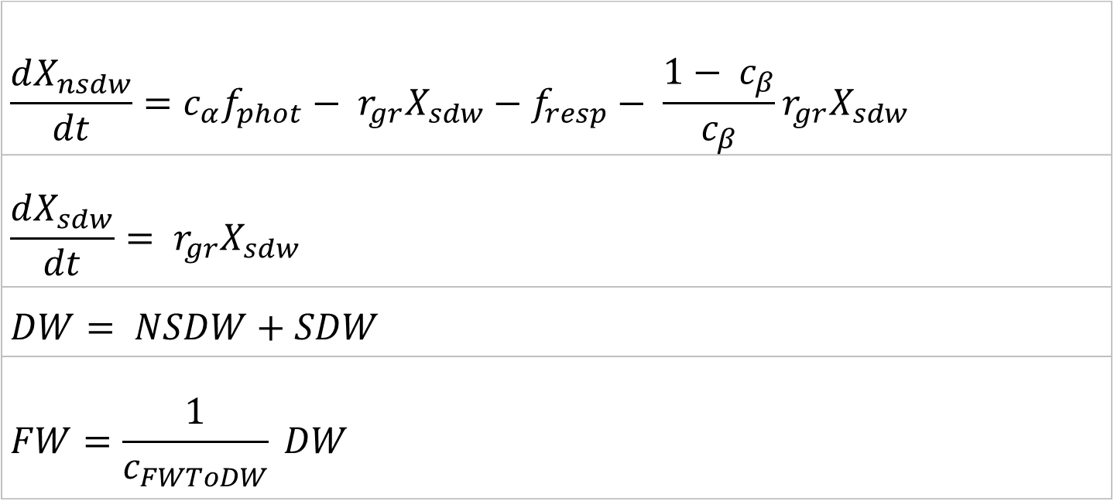
6. Model for crop growth
U_{PAR}: photosynthetic active radiation, U_{t}: canopy temperature, U_{CO2}: carbon dioxide concentration in greenhouse air, X_{NSDW}: non-structured dry weight, X_{SDW}: structured dry weight
$$\frac{dX_{nsdw}}{dt}=c_{α}f_{phot}− r_{gr}X_{sdw}−f_{resp}− \frac{1− c_{β}}{c_{β}}r_{gr}X_{sdw}$$
$$\frac{dX_{sdw}}{dt}= r_{gr}X_{sdw}$$
$$DW= NSDW+SDW$$
$$FW=\frac{1}{c_{FWToDW}} DW$$
Notes:
And based on these input values, the model calculated two kinds of dry weights as shown on the top two equations and converted them into fresh weight.
------------------------------------------------------------------------
Just say dry weight, not explain the difference of nsdw and sdw

Slide 28
6. Model for crop growth: Validation
Compare calculated crop fresh weight with measured (Kacira et al., 2017)
Notes:
This is the validation result of the crop growth model.
Using the same environment data, I compared the estimated fresh weight with the measured final fresh weight from other literature.
This graph shows that the estimated value was quite close to the weight of large size cultivars (Magenta and Cherokee) but somewhat overestimated for the medium size cultivars. You will need to reduce the output to some extent when you assume the weight of medium or small size cultivars.

Slide 29
6. Model for crop growth: Example
Lettuce fresh weight per head for whole simulation days (r_{PV} = 0.5)
When this fresh weight ＜200*0.9, the harvest is ignored
Notes:
This figure shows the crop fresh weight per head for the whole simulation period when OPV coverage ratio was 50 %. Each blue sequence is one cultivation cycle, and when the head weight is close to 200 g, I let the program harvest the lettuce and restart the cultivation.
By default, I defined the simulator not to harvest the crop when the final fresh weight was less than 90 % of the expected final fresh weight, which is 180 g in this case,
So, the total fresh weight for the whole simulation period is the summation of these green dots more than 180 grams..

Slide 30
Overall Model Flow
1. Solar irradiance to tiled PV
4. Electrical energy production
7. Electrical power sales/cost
2. Transmittance thru multi-span roof
5. Energy consumption by cooling/heating
9. Economic profit
8. Crop production sales/cost
3. Light intensity to plants thru shading curtain
6. Crop growth and yield
Notes:
The next model is for Energy consumption by cooling and heating

Slide 31
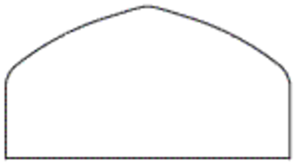

5. Energy consumption by cooling/heating
$$Q_{V} = Q_{SR}−(Q_{LH} + Q_{SH} + Q_{LW})$$
Q_{SR} (W): Solar irradiance to lettuce
Q_{LH} (W): Cooling by transpiration from GH
Q_{SH} (W): Sensible heat thru greenhouse covering material
Q_{LW} (W): Thermal longwave radiation
Q_{V} (W) : Required energy for cooling/heating
If Q_{V} is negative, heating (natural gas heater), Q_{VCool}.
If Q_{V} is positive, cooling (pad and fan), Q_{VCool}.
Q_{LW}
Q_{SR}
Q_{LH}
Q_{SH}
Notes:
This is the energy balance equation I defined. This equation was used to calculate the required cooling and heating energy to maintain the greenhouse temperature.
The righthand side consists of …
Q_SR, the solar irradiance into the greenhouse,
Q_LH, the cooling effect by transpiration as latent heat
Q_SH, the sensible heat through greenhouse walls and roofs
Q_LW, the thermal long wave radiation emission
The difference between these elements was supposed to be controlled to maintain the greenhouse temperature, which is Q_V.
So if Q_V is positive, we need to remove the excessive heat. So we wanna cool the greenhouse.
if it is negative, we need to add the same amount of energy by heating.
----------------------------------------
液化する: liquefy

Slide 32
5. Energy consumption by cooling/heating
Energy balance transition on Oct 1st 2015.
Notes:
This is a result of the energy balance model. It is showing how each energy factor changes on October 1st.
The blue line is the required cooling/heating energy Q_V,
The orange line is Solar irradiance to lettuce (Q_SR)
The gray is the cooling effect by transpiration (Q_LH),
The yellow line is the sensible heat through greenhouse covering materials (Q_SH,)
and the light blue line is the longwave radiation (Q_LW).
Since these curves considers the effect of shading curtain, Solar irradiance to lettuce decreased from 11 to 15, which also led decreasing Q_V.
We can also see Q_LW is very small, and the lettuce has not grown very much on this day because the transpiration cooling energy is not so large (show the next slide).

Slide 33
5. Energy consumption by cooling/heating: Validation
Energy balance transition on Jan 31st 2015, two days before harvest.
Notes:
If we compare this figure with the last one, we can see the simulator correctly calculated the transpiration effect as the crop becomes matured.
The gray line shows the transpiration effect by the crop two days before harvest. You can observe the transpiration cooling increased to this level.

Slide 34
Overall Model Flow
1. Solar irradiance to tiled PV
4. Electrical energy production
7. Electrical power sales/cost
2. Transmittance thru multi-span roof
5. Energy consumption by cooling/heating
9. Economic profit
8. Crop production sales/cost
3. Light intensity to plants thru shading curtain
6. Crop growth and yield
Notes:
Now we can calculate the sales and cost of crop production with the output variables of Model 5 and 6.

Slide 35

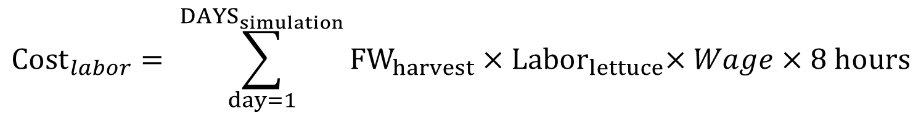
8. Crop production sales/cost
$${Sales}_{lettuceTotal}=S_{cultivation}\sum_{day=1}^{{DAYS}_{simulation}}{d_{plant} × {Sales}_{headLettuce}}$$
Sales_{lettuceTotal} [USD]: Total lettuce sales price for whole simulation period
S_{Cultivation} [m²]: Cultivation floor area (0.9 of the GH floor area)
d_{plant} [25 head m⁻²]: Plant density
Sales_{headLettuce} [1.99 USD head⁻¹]: Lettuce sales per head
$${Cost}_{labor}= \sum_{day=1}^{{DAYS}_{simulation}}{{FW}_{harvest}}{×Labor}_{lettuce}×Wage×8 hours$$
Cost_{labor} [USD]: Total labor cost
FW_{harvest} [kg]: total harvested fresh weight
Labor_{lettuce} [0.315 labor person 10000kg⁻¹]: necessary labor per 10000 kg yield
Wage [12.79 USD labor⁻¹ hour⁻¹]: Lettuce sales per head
Notes:
The top equation calculates the total sales price by multiplying the plant density, sales price per head and the cultivation area.
Since the greenhouse lettuce is not generally sold per weight but per head, the sales was calculated based on the number of heads.
And the next equation is for the cultivation labor cost. It was calculated with the total harvested fresh weight, the labor person required for 10000 kg cultivation, and the wage in Tucson.
--------------------------------
Labor_{lettuce} [0.315 labor person 10000kg⁻¹]: necessary labor per 10000 kg yield
from Eaves, J., & Eaves, S. (2018). Comparing the Profitability of a Greenhouse to a Vertical Farm in Quebec. Canadian Journal of Agricultural Economics, 66(1), 43–54. https://doi.org/10.1111/cjag.12161
Wage [USD labor⁻¹ hour⁻¹]: Lettuce sales per head
` from “Occupational Employment and Wages in Tucson — May 2017”, United States Department of Labor (last accessed on June 18th, 2018), (https://www.bls.gov/regions/west/news-release/occupationalemploymentandwages_tucson.htm)

Slide 36
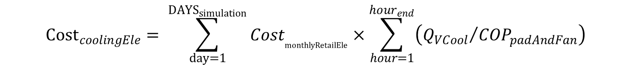

8. Crop production sales/cost
$${Cost}_{coolingEle}= \sum_{day=1}^{{DAYS}_{simulation}}{{Cost}_{monthlyRetailEle}×\sum_{hour=1}^{{hour}_{end}}{\left({Q_{VCool}}/{{COP}_{padAndFan}}\right)}}$$
Cost_{coolingEle} [USD]: Total cooling cost for cultivation by pad and fan
Cost_{monthlyRetailEle} [USD kWh⁻¹]: residential electricity price each month per kWh (10.99 – 12.78)
Q_{VCool} [W]: required cooling energy
COP_{padAndFan} [-]: COP (coefficient of performance) of pad and fan cooling (15)
$${Cost}_{NG}= \sum_{day=1}^{{DAYS}_{simulation}}{{Cost}_{monthlyGas}×\sum_{hour=1}^{{hour}_{end}}{\left(Q_{VHeat}×c_{heater}\right)}}$$
Cost_{NG} [USD]: Total heating cost for cultivation by natural gas heating
Cost_{monthlyGas} [USD 1000 ft⁻³]: residential natural gas price at Arizona (12.75 – 24.1)
Q_{VHeat} [W]: required heating energy
c_{heater} [-]: thermal efficiency of heating equipment (0.9)
Notes:
The model also considered the cost for cooling and heating. The first equation is for cooling cost and the second is for heating cost.
The cooling cost was calculated with the total cooling energy which was calculated in the previous model, and the unit price of electricity and the COP (coefficient of performance) of pad and fan system
Likewise, the heating cost was derived from the total heating energy, natural gas unit price for heating and the thermal efficiency of the heating equipment which was assumed to be 0.9.
----------------------------------------
Gas price: https://www.eia.gov/dnav/ng/hist/n3010az3m.htm

Slide 37
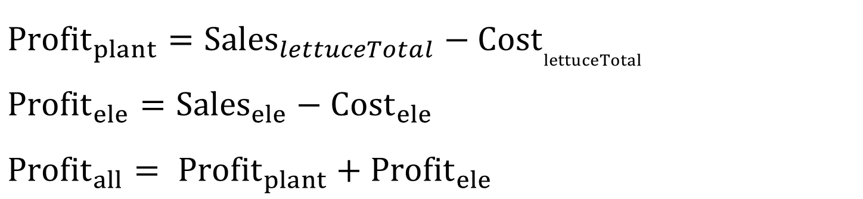
9. Economic profit
From Model 8. Crop production sales/cost
$${Profit}_{plant}={Sales}_{lettuceTotal}−{Cost}_{lettuceTotal}$$
$${Profit}_{ele}={Sales}_{ele}−{Cost}_{ele}$$
$${Profit}_{all}= {Profit}_{plant}+{Profit}_{ele}$$
From Model 7. Electrical power sales/cost
Notes:
These are the final equations. Since we finally calculated the sale and cost of electricity and crop, we get the total economic profit by totalizing all of them.

Slide 38
Results & Discussion
(case simulation & optimization)
Notes:
From here, I would like to show the results of the simulation with some different conditions, and the optimization.

Slide 39
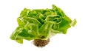
Simulation cases (one year): OPV coverage and cultivation
 | Cultivation season (Jan 1 ~ May 31) | Summer season (June 1 ~ Sept 15) | Cultivation season (Sept16 ~ Dec 31)
Case1
Case2
Case3
OPV 0 -100%
OPV 100%
OPV 0 - 100%
OPV 0 -100%
OPV 50%
OPV 0 - 100%
OPV 0 -100%
OPV 100%
OPV 0 - 100%
Notes:
I simulated the model with these three cases as shown here
In case 1, I assumed to grow lettuce during the cultivation seasons, which are Jan 1 to May 31st and September 16th to December 31st, and not grow lettuce during the summer season, June 1st to September 15th. And the OPV coverage ratio was 100%, which means the greenhouse roof was completely covered by the OPV module..
In case 2, we grow lettuce during the cultivation season like Case 1, but in the summer season we grow lettuce and fixed the OPV coverage ratio by 50%.
In case 3, the OPV coverage ratio was fixed to be 100 % in summer, and the other conditions were same as those of Case 2.

Slide 40
Simulation results (one year): Energy production and crop yield with variable OPV coverage in the cultivation season
Case 1 & 3
Case 2 & 3
Case 2
Case 1
Notes:
This figure shows the generated electricity and crop weight per greenhouse floor area for all the cases with variable OPV coverage ratio during the cultivation season.
The key findings are
first, the crop yield at Case 2 and 3 were almost same even though the OPV coverage ratio in the summer season was different
and second, the crop yield did not change so much by changing the OPV coverage ratio from 0 to 1.
These were caused because the shading curtain deployment time was flexibly changed according to the OPV coverage ratio. You can imagine the more OPV module was used, the less frequently the shading curtain was used which led almost equivalent solar irradiance to plants.
Anyway, as you can see, this simulator succeeded to estimate the electricity and crop yield according to the change of these factors.
--------------------------------------

Slide 41
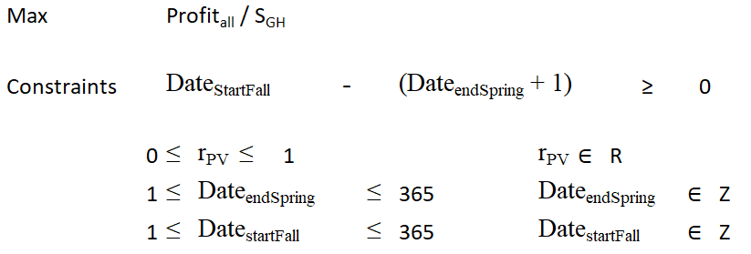
Optimization results: Problem statement
Profit_{all} / S_{GH} (USD m⁻²) : Total economic profit per GH floor area
r_{PV} (-) : OPV coverage ratio
Date_{endSpring} (days): Spring end date
Date_{StartFall} (days): Fall start date
The summer period: the period btw Date_{StartFall} and Date_{endSpring}
Notes:
Next, I would like to explain about the optimization.
Here is the mathematic format of the optimization problem I defined: the objective function was the total economic profit per greenhouse floor area, and the constraint function was only this one meaning “the fall start date was later than the spring end date”.

Slide 42
Optimization results: Solver for optimization
MIDACO Solver (http://www.midacosolver.com/index.php/download)
Handle MINLP problem by python
Combine an extended evolutionary Ant Colony
Optimization (ACO) with the Oracle Penalty Method
ACO = a meta-heuristic algorithm (problem independent), fast and moderately accurate but not guaranteed to converge in the global solution
Notes:
I personally purchased a solver for optimization called MIDACO solver. It is written in python, and can handle MINLP: mixed integer non liner programming problem, a problem including integers and real numbers as parameters and the objective function can be a non-linear function.
The solver’s algorithm is based on Ant Colony Optimization which imitates the way for ants to collect foods with pheromone. This algorithm is a meta-heuristic algorithm, which means we can apply this algorithm to any kinds of problems, but it is not guaranteed to reach at the global solution. So, we need to run the solver several times to have a reasonable output and analyze the optimized parameters.

Slide 43
Optimization results
The profit when selling lettuce per head, starting from 1, 1, and 0.0 as the initial values.
Grow in summer? | Profit_{All} / S_{GH} | r_{PV} | Date_{endSpring} | Date_{startFall}
No | 421.3 | 0.986 | 2 (2nd Jan) | 7 (7th Jan)
Yes | 458.9 | 0.230 | 4 (4th Jan) | 6 (6th Jan)
The profit when selling lettuce per head, starting from 183, 183, and 0.5 as initial values
Grow in summer? | Profit_{All} / S_{GH} | r_{PV} | Date_{endSpring} | Date_{startFall}
No | 305.6 to 460.5 | 0.574 to 0.882 | Unfixed | Unfixed
Yes | 460.5 | 0.580 | 186 (5th July) | 195 (14th July)
Notes:
Here are the optimization results.
The optimization was conducted from three different initial points as shown here (also show the next page).
The results showed that the objective function was maximized when we grow lettuce in summer and the OPV coverage ratio was 58%.

Slide 44
Optimization results
The profit when selling lettuce per head, starting from 365, 365, and 1.0 as the initial values.
Grow in summer? | Profit_{All} / S_{GH} | r_{PV} | Date_{endSpring} | Date_{startFall}
No | 419.9 | 1.0 | 362 (28th Dec) | 364 (29th Dec)
Yes | 418.8 | 0.992 | 362 (28th Dec) | 364 (29th Dec)
The optimal scenario:
Growing in summer with 0.58 OPV coverage ratio, which gives 460.5 USD m⁻²
Notes:
And the value was 460.5 USD m⁻²

Slide 45
Optimization results: Discussion
Economic profit per GH floor area vs OPV coverage ratio, summer period from 2 to 7 Jan (not growing lettuce in summer)
Local Optimal point!
Notes:
To verify the point is the optimal, I made some analysis.
This figure shows the transition of the economic profit with various OPV coverage ratio, assuming not growing lettuce in summer.
The profit increased little by little as the OPV coverage ratio increases, and the profit was maximized when the coverage ratio was almost 100%. You can also see the profit did not increase so much even with 100 % coverage ratio, just 5 USD per m⁻²

Slide 46
Optimization results: Discussion
Economic profit per GH floor area vs OPV coverage ratio (growing lettuce in summer)
Global optimal point
Total annual lettuce yield:57.9 kg m⁻²
Annual electricity produce: 47.7 kWh m⁻²
(satisfying 45.7% of the total electricity consumption)
Notes:
This is the graph where we assumed to grow lettuce in summer.
As you can see, the objective function was larger than that of the last figure, which means this condition makes more profit.
And another difference is a sudden reduction when the OPV coverage was around 50%, which was not observed in the last figure.
The reason it happened was the simulator ignored the harvest whose head weigh was less than 90 % of the maturity weight. I tell you a bit more detail about it in the next slide.
-------------------------------------------
As we saw, the shading curtain mitigates the impact of OPV film but the small reduction of solar irradiance can make a big impact because of the sales method.

Slide 47
Optimization results: Discussion
Lettuce fresh weight per head for whole simulation days (r_{PV} = 0.5)
When this fresh weight ＜200*0.9, the harvest is ignored
Notes:
This is the figure I already showed in crop growth model description, which shows the crop fresh weight per head for the whole simulation period when OPV coverage ratio is 50 %.
As I said, each blue sequence is one cultivation cycle, and when the head weight was close to 200 g, I let the program harvest the lettuce and restart the cultivation.
And if the final fresh weight was less than 90% of the harvest weight, I made it ignore that crop cycle.
Please look at the final cycle. The final weight seems to be at the border of the 90% line right? I am thinking the program ignored or considered the crop by a slight difference around the border.
Anyway, through these analyses, we can verify the optimization worked correctly, and the optimal condition is growing lettuce in summer and use OPV film by 58% of the roof area.

Slide 48
Conclusions
Each sub-model reasonably predicted solar radiation, crop yield and cooling/heating energy compared to the measured data from previous research and literature.
The optimization results revealed that the overall profitability could increase if lettuce crop is cultivated during summer even considering the cost increase by labor and cooling cost.
At the economically optimal conditions, the OPV module coverage ratio was 58.0% when OPV and shading curtain initial cost were zero.
The OPV’s impact to the total economic profit was much smaller than that of lettuce with shading curtain.
Notes:
This is all about my research, and I would like to end my presentation with the conclusion as a summary.
1st , all parts of the model successfully estimated each output.
2nd , the optimization analysis proved we can improve the profitability by growing lettuce in summer
3rd , with the initial parameters I defined, the economic profit was maximized at 58% OPV coverage ratio, but this value will highly change by the change of environment and economic conditions
And lastly, the economic impact of OPV module was much smaller than that of crop production when we use shading curtain simultaneously.
----------------------------

Slide 49




Acknowledgements
Committee Members
Dr. Lingling An
Dr. Young Jun Son
Dr. Murat Kacira (Advisor)
Binational Agricultural Research and Development Funds (BARD), Project No: US-4885-16.
Volcani Research Center
ARO-Israel
Notes:
I would like to express thanks to my committee members and acknowledge the funding sponsor Binational Agricultural Research and Development Funds.

Slide 50
Thank you

Slide 52
Appendix

Slide 53
Problem Statement: Pros and Cons of OPVs
Advantages | Disadvantages
Easily tune of light absorbing spectrum, color schemes and thickness Physically Flexible like plastic film (easily attach to roofs) Lower manufacturing cost Low environmental impact during manufacturing and operations | Low cell efficiency Expensive due to small supply Unknown (shorter in general) lifetime under real climates
Mohammad Bagher2014, Gevorgyan et al., 2016
Notes:
Advantage:
You can flexibly change many properties like the design because it is flexible, and colors, which means you can tune the absorbed light spectrum.
And, if it is made in a large quantity, the manufacturing cost can be decreased more than that of inorganic ones by using a conventional printing technology.
These are the main disadvantages .
The biggest one is the low cell efficiency. It is still much smaller than that of inorganic modules.
Second, this is big too. It is expensive.
And third, the lifetime is unstable, especially under a real environment. But, according to the actual OPV I got, it is much shorter.

Slide 54
PV integration into Greenhouse Systems: Basic idea
Alleviate the competition of the land demand for farming and solar power generation.
Make use of the excessive solar energy of farming for power generation (especially arid and semi-arid climates).
Possible to generate some electric energy not decreasing plant yield by the reduction in light intensity + run greenhouse without grid system.
Improve profitability and sustainability
These can be verbally said while showing slide # 2 or 3, and then you can eliminate this slide.
Notes:
The main strengths of Agrivoltaics are first, you can alleviate the competition of the land demand for farming and solar power generation.
And second, you can make use of the excessive solar energy of farming for power generation. This is especially effective in arid and semi-arid climates because the sunlight is often too strong for farming.
With these strengths, it is possible to generate some electric energy not decreasing plant yield by the reduction in light intensity, and run greenhouse apart from power grid system. Therefore, it is said it can improve the profitability and sustainability of greenhouse farming.
Integrate this into slide 2

Slide 55
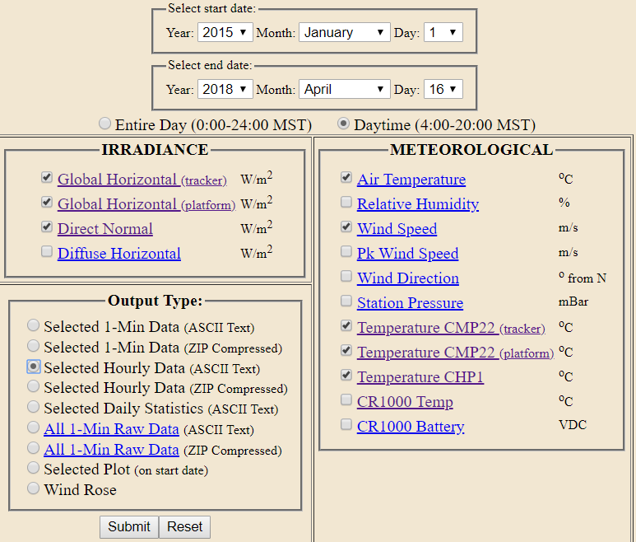
Environment data
SOLRMAP University of Arizona (OASIS) https://midcdmz.nrel.gov/ua_oasis/
Choose data period and items
Solar irradiance was estimated.
Notes:
Delte this
And here is the assumed OPV spec, which is quite bad, but this is the property of the film we purchased.
The color is blue and the whole size per roll is about 6 by 1 square meters. The cell efficiency is 1.37%, and the transmittance was assumed to be 30% from the spectrum.
-------------------------------------------------
Blue light wavelength 400 to 500
Green 500 to 600
Red 600 to 700 nm
NI 700 ~ 800 nm
IIR 800 – 1400 or 2000 nm
Eplxiain these also.

Slide 56
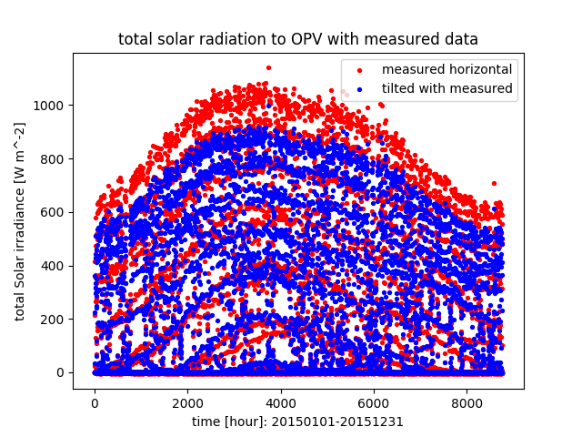
Simulation result : solar radiation
Notes:
Shows the difference of solar radiation to horizontal surface and tilted surface like greenhouse roof for 1 year.

Slide 57
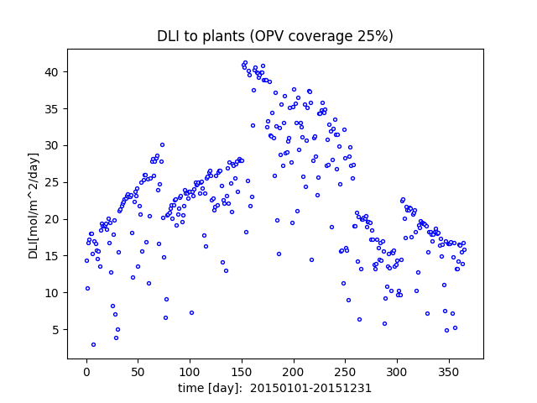
Simulation result
Notes:
Explain the effect of shading curatin.

Slide 58
Model description (mathematic detail)
Want to calculate the solar radiation on this surface.

Slide 59
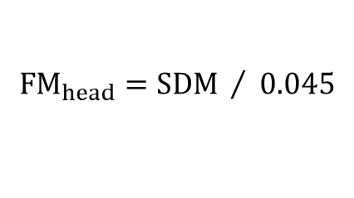
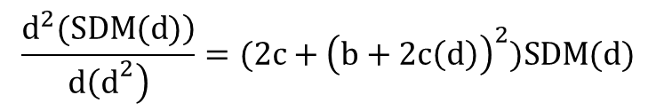
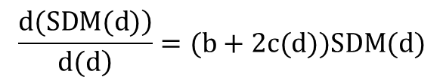
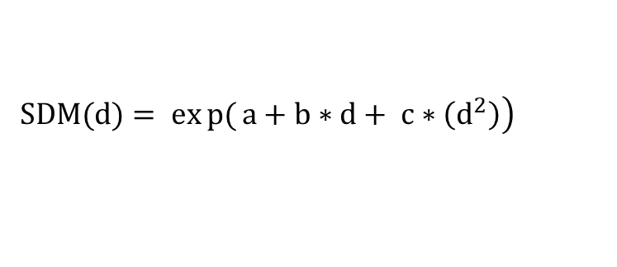
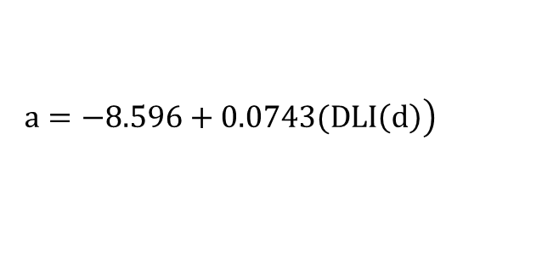
6. Model for plant growth
Lettuce crop growth model (Both, 2003) used with Taylor expansion for daily dry mass weight increase, so that the model can consider the DLIs. Van hentenのに変更する。
$$SDM\left(d+1\right)≈SDM\left(d\right)+\frac{1}{1!}\frac{d\left(SDM\left(d\right)\right)}{d\left(d\right)}h+\frac{1}{2!}\frac{\left.d^{2}(SDM(d)\right)}{\left.d{\left(d\right.}^{2}\right)}h^{2}+\frac{1}{3!}\frac{\left.d^{3}(SDM(d)\right)}{\left.d{\left(d\right.}^{3}\right)}h^{3}$$
$$d∈Z, \left[1,{Days}_{cycle}\right], h=1, {DAYS}_{ctcle}=35$$
$$\left.SDM(d)= exp{(}a+b∗d+ c∗\left(d^{2}\right)\right)$$
$$\left.a=−8.596+0.0743(DLI\left(d\right)\right)$$
$$b=0.4822 c= −0.006225$$
$$\frac{\left.d(SDM(d)\right)}{\left.d(d\right)}=(b+2c(d))SDM(d)$$
$$\frac{\left.d^{2}(SDM(d)\right)}{\left.d{\left(d\right.}^{2}\right)}=(2c+{\left(b+2c\left(d\right)\right)}^{2})SDM(d)$$
$$\frac{\left.d^{3}(SDM\right)}{\left.d{\left(d\right.}^{3}\right)}=2c\frac{\left.d(SDM(d)\right)}{\left.d(d\right)}+4c\left(b+2c\left(d\right)\right)SDM\left(d\right)+ {\left(b+2c\left(d\right)\right)}^{2}SDM(d)$$
$${FM}_{head}=SDM / 0.045$$
Notes:
And this is the last block. This estimates the daily plant growth based on the DLI derived by the last slide.
These equations were developed using the idea of Taylor expansion so that it can consider the daily change of DLI.
So, in the program, it iterates the first formula as many times as the assumed cultivation days, which is 35 days in this model.

Slide 60
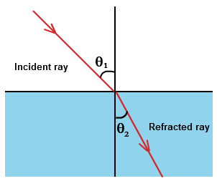
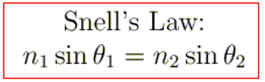
3. Model for the solar transmittance of multi-span greenhouse
Preparation for the transmittance calculation
Index of refraction = n₁
Index of refraction = n₂
Refractive index of air (1 atm, 0 celsius degree) n₁ = 1.00029
Refractive index of PE n₂ = 1.500
Notes:
Do not use it

Slide 61
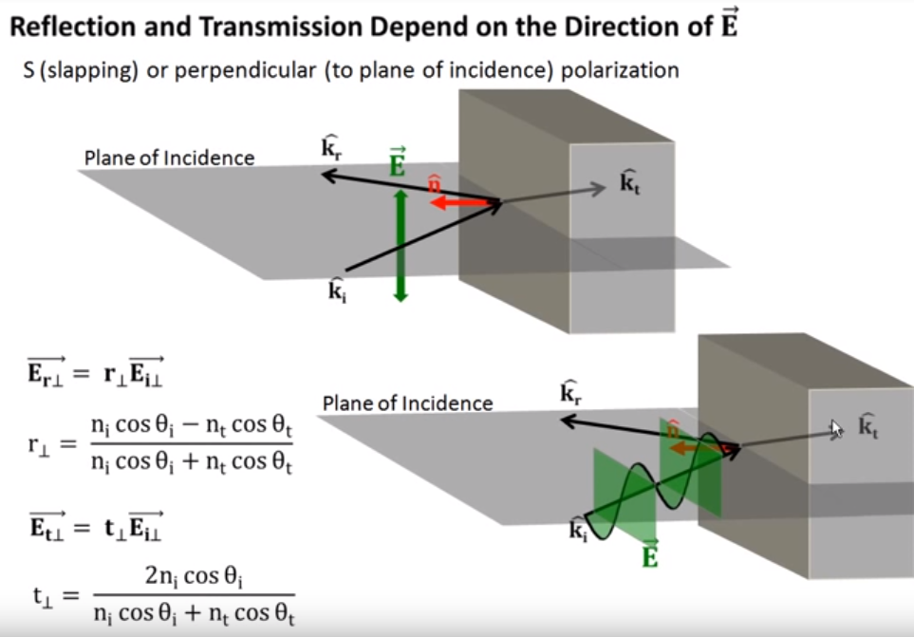
3. Model for the solar transmittance of multi-span greenhouse
Preparation: Fresnel’s equation
Reflection coefficient
Transmittance coefficient
Notes:
Do not use it

Slide 62
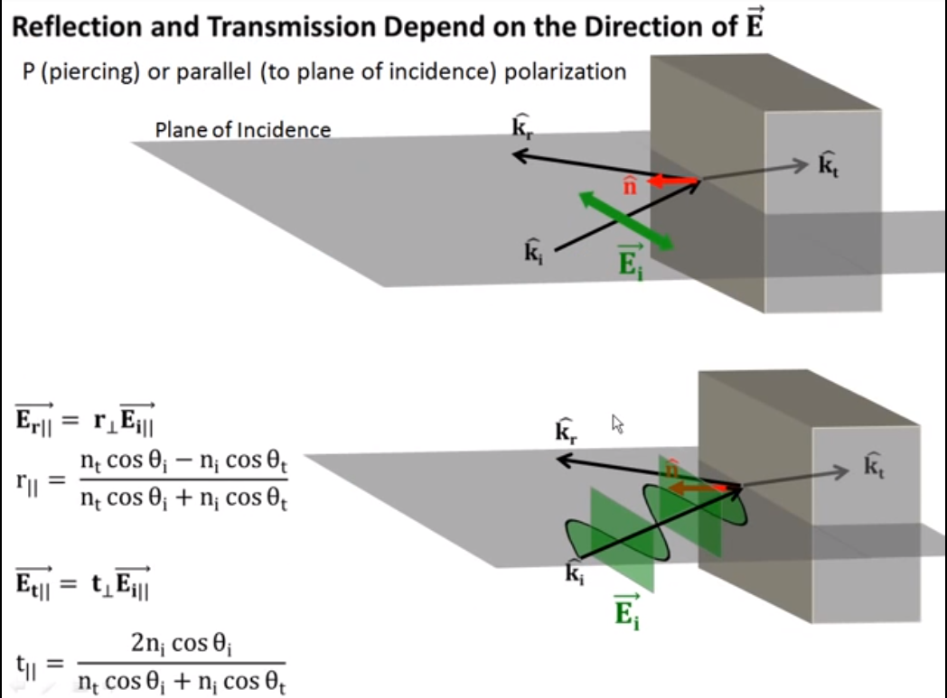
3. Model for the solar transmittance of multi-span greenhouse
Preparation: Fresnel’s equation
Reflection coefficient
Transmittance coefficient
Notes:
Do not use it

Slide 63




3. Model for the solar transmittance of multi-span greenhouse
Case 1: if β > E
Where $m=Int \left\{\frac{1}{2}\left(1+\frac{\tan{φ}}{\tan{E}}\right)\right\}$
East <-> West
Notes:
Do not use it
Deter the equation numbers (A5) and do

Slide 64
3. Model for the solar transmittance of multi-span greenhouse
Case 2: if β <= E < 2β
Notes:
Not use

Slide 65
3. Model for the solar transmittance of multi-span greenhouse
Case 3: if 2β <= E < 3β
Notes:
Not use

Slide 66
3. Model for the solar transmittance of multi-span greenhouse
Case 4: if 3β <= E
If the sun passes the noon, the direction of solar radiation becomes opposite!!
Notes:
Not use

Slide 67
4. Model for light intensity to plants
Solar irradiance to horizontal surface, not tilted surface.
Albedo radiation was ignored.
$$I_{multispan}=TmultiSpan\left( I_{DH}+I_{S}\right)$$
$$I_{opv}={ Tr}_{opv}\left\{\left(r_{opv}){ I}_{multispan}+ \left(1−r_{opv}\right)I_{multispan}\right.\right\}$$
I_{ghStructure}$= {Tr}_{ghStructure}$ * I_{opv}
(If the simulation date is during the period when deploying shading curtain)
$$I_{plant}={Tr}_{curtain}\text{∗ }\text{I}\text{ghStructure}$$
(Else if the simulation date is out of the period when deploying shading curtain)
$$I_{plant}=\text{I}\text{ghStructure}$$
$I_{plant}$[W m⁻²]: total solar irradiance to plants on ground
Notes:
H = direct solar radiation
H_d = diffuse solar radiation
H_d,p = albedo solar radiation (the ground reflected radiation)
H_T = total solar radiation
This slide shows the equations calculating the electricity yield and light intensity to plants in the greenhouse.
The first equation uses the total solar radiation to the tilted surface, that is H_T in the last slide, and the second part uses the radiation to horizontal surface.
The rest of the part considers the transmittance of OPV film, plastic covering, greenhouse structures, and shading curtain. Finally, it convers its unit from PPFD to DLI.

Slide 68
Simulation result : Energy production and crop yield with variable OPV coverage in the cultivation season
Case 2
Case 1 & 3
Case 3
Case 2
Case 1
Notes:
Use 1.7%
And this is other main simulation result. This graph expresses how much total plant fresh weight per area and electricity per greenhouse floor area were made with different OPV coverage in the cultivation season for the whole simulation period.
The curved lines show the plant fresh weight and the straight lines are for electricity yield.
So, for example, if you want compare the plant yield in Case 1 and 3 with 40% OPV coverage ratio, you want to check these numbers, and you can see the electricity yield was around 10.5 kWh m^-2.
The merit of this graph is, if you know the necessary electricity to operate a greenhouse, you can estimate the necessary OPV coverage ratio which fills the consumption and the expected yield reduction.
I showed only 3 cases here, but the program can simulate quite flexibly as you want, like, with different simulation period, summer season, greenhouse size, and any constant variable.

Slide 69
Sensitivity analysis (future work)
Factors to analyze (±1%, ±5% )
Lettuce price [USD head⁻¹]
Electricity unit price [USD kwh⁻¹
Labor cost [USD hour⁻¹] -> No
OPV module purchase cost [USD m⁻²] -> do this
OPV coverage ratio [-] -> do this
OPV transmittance [-]
OPV degradation ratio [-]
Solar irradiance [W m⁻²] -> No
Distance between crops (crop density) [m]
OPV cell efficiency [-] -> do this
Objective function
Economic profit per area [USD m⁻²]

Slide 70
Optimization (future work)
Decision variables (num of params)
1. PV module coverage ratio: (1)
2. Shading curtain deployment period (month) : (4)
3. Shading curtain deployment time during a day (hour): (2)
Data range
1. 0.0 – 1.0
2-1. Before summer: Jan 1st – Jul 31st
2-2. After summer: Aug 1st – Dec 31st
3. 6:00 (sunrise) – 20:00 (sunset)
Type of the problem
MINLP (Mixed Integer Non-liner Problem)
The model includes both integer and real values, and not liner function
Notes:
The program calculates these optimized values maximizing the economic profit.

Slide 71


Optimization solver (future work)
MIDACO Solver (http://www.midacosolver.com/index.php/download)
Handle MINLP problem by python
Combine an extended evolutionary Ant Colony
Optimization (ACO) with the Oracle Penalty Method
Derive global optimal solution
Notes:
I used python with a solver called MIDACO which can solve various types of NLPs which cannot be solved by CPLEX.

Slide 72
Chose only sunny days each month

Slide 73

U.S. Solar Photovoltaic installation costs (USD/)
Notes:
These graphs just show a the transition of the cost for installing traditional PV module.
As you can see, the installation cost has been decreasing. So it is expected that agrivoltaics will propagate more in the future.
--------------------------------------------
[Possible question]
what is the price of OPV film?
our OPV = 115W / 6m^2 and 254.03 USD/m^2
so, 254.03 * 6 / 115 = 13.25374 , which only included the module price and inverter price.
254.03 / 115 = 2.208957
The price of PV module (for residence)
2.93USD/watt, which includes all of the installation cost.

Slide 74
Modeled OPV material
Organic photovoltaic film
Manufactured by Opvius
7.68W sheet⁻¹ (0.85m x 0.66m)
1.37% cell efficiency
30% assumed transmittance
Transmittance of OPV film
Notes:
Again, you can change any characteristics, but here is the modeled OPV specification.
It has quite low efficiency, but this is a real number of the film we purchased.
-------------------------------------------------
Blue light wavelength 400 to 500
Green 500 to 600
Red 600 to 700 nm
NI 700 ~ 800 nm
IIR 800 – 1400 or 2000 nm
Eplxiain these also.

Slide 75



2. Model for solar radiation on tilted OPV (greenhouse roof)
solar declination angle [rad]
$$δ=\frac{23.45π}{180}\sin\left(2π\frac{284+n}{365}\right)$$
hour angle (approximation) [rad]
$$ω= \frac{hours after noon}{4}$$
solar elevation angle [rad]
$$α= \sin^{−1}\left(\cos\left(φ\right)\cos\left(δ\right)\cos\left(ω\right)+\sin\left(φ\right)\sin\left(δ\right)\right)$$
(derived from Yano et al., 2009)
solar azimuth angle [rad]
$$ψ_{s}= \cos^{−1}\frac{\sin\left(α\right)\sin\left(φ\right)− \sin\left(δ\right)}{\cos\left(α\right)\cos\left(φ\right)}$$
incident angle of the beam sunlight on the module surface [rad]
$$γ= \cos^{−1}\left(\sin\left(α\right)\cos\left(β\right)+ \cos\left(α\right)\sin\left(β\right)\cos\left(ψ_{s}−ψ_{p}\right)\right)$$
Notes:
-------------------------------------------------
The declination angle $δ$
n was the number of the day in the year from first January
The solar hour angle $ω$
The solar altitude angle $α$
$φ$ (rad) was the latitude of the greenhouse location
The solar azimuth angle $ψ_{s}$ (rad)
The incident angle of the beam sunlight on the module surface $γ$ (rad)
$ψ_{p}$ (rad) was the module azimuth angle, the angle between the normal to the OPV module surface and the true south
The $β$ (rad) was the tilt angle of OPV module
$θ_{Z}$ (rad) was the zenith angle, which is $(π/2− α)$ rad.
the measured diffuse radiation I_TS
ρg = ground reflectance
--------------------------------
Definition of hour angle: https://www.britannica.com/science/hour-angle
Definition of declination angle: http://pveducation.org/pvcdrom/properties-of-sunlight/declination-angle

Slide 76

Modeling result: solar radiation on tilted OPV (greenhouse roof)
Notes:
Blue line: solar irradiance to the OPV facing east
Orange line: solar irradiance to the OPV facing west

Slide 77
5. Energy consumption by cooling/heating: Validation
Energy balance transition on Jan 1st 2015.
Notes:
Transition of energy balance elements on 1st January 2015, just started cultivating the crop, which makes little transpiration. No shading curtain was deployed.

Slide 78
5. Energy consumption by cooling/heating: Validation
Energy balance transition on Jan 31st 2015, two days before harvest.
Notes:
Transition of energy balance elements on 30th January 2015, two days before harvesting the crop. No shading curtain was deployed.

Slide 79
5. Energy consumption by cooling/heating: Validation
Energy balance transition on Apr 1st 2015.
Notes:
Transition of energy balance elements on 1st April 2015. The shading curtain was deployed from 8:00 to 17:00.

Slide 80
5. Energy consumption by cooling/heating: Validation
Energy balance transition on Jul 1st 2015.
Notes:
Transition of energy balance elements on 1st July 2015. The shading curtain was deployed for the whole day time.

Slide 81
Simulation results: Economic profit Case 1 (365 days simulation)
Coverage ratio during cultivation period | 25 | 25 | 25 | %
Cell efficiency | 1.37 | 1.37 | 15 | %
PV module price per area | 221 | 50 | 50 | USD m⁻²
Depreciation period | 365 | 365 | 365 | Days
electricity sales | 1342.6 | 1342.6 | 14693.7 | USD
PV module Depreciation cost | 354528.6 | 80225.0 | 80225.0 | USD
Crop produce sales | 106086.6 | 106086.6 | 106086.6 | USD
Crop produce sales per GH floor area | 79.5 | 79.5 | 79.5 | USD m⁻²
Labor cost | 27966.2 | 27966.2 | 27966.2 | USD
Crop produce cost per GH floor area | 20.9 | 20.9 | 20.9 | USD m⁻²
Economic profit | -275065.6 | -761.9 | 12589.1 | USD
Economic profit per GH floor area | -206.0 | -0.6 | 9.4 | USD m⁻²
Notes:
Lastly, I would like to show the economic profit at Case 1 with different OPV module specification, which is the goal of the simulation.
The first column shows,…
In the second column,…,
And in the third,…
This is just an example and I still need to improve the model as I mention later, but in this way, we can simulate many characteristics of PV module and calculate the profitability.
I hope this simulation helps farmers’ decision making on PV module installation and it help us find the specification of OPV film which compete with conventional inorganic PV module.
----------------------------
Penalty functionを考慮してないからElectricityが不利だということを言及する。
-----------------------------------------------------------------------------------------------
Why the crop produce per GH floor are is small???
1 the cultivation floor are is 1335.024 m^2 and the total GH floor are is 798.237. m^2. x 0.59792
2 the plant density is 25 heads/m^2 instead of higher values like 40 and 50.
3 the sales price per kg is = around 4.409171 Usd per kg = around 0.9 USD per head.
Here is the source of the price the right most column [USD per pound]
['APU0000FL2101' '2015' 'M01' '2.047']
['APU0000FL2101' '2015' 'M02' '2.195']
['APU0000FL2101' '2015' 'M03' '2.007']
['APU0000FL2101' '2015' 'M04' '1.868']
['APU0000FL2101' '2015' 'M05' '1.904']
['APU0000FL2101' '2015' 'M06' '1.977']
['APU0000FL2101' '2015' 'M07' '1.848']
['APU0000FL2101' '2015' 'M08' '1.790']
['APU0000FL2101' '2015' 'M09' '1.926']
['APU0000FL2101' '2015' 'M10' '1.953']
['APU0000FL2101' '2015' 'M11' '2.116']
['APU0000FL2101' '2015' 'M12' '2.205’]
Source: https://data.bls.gov/timeseries/APU0000FL2101?amp%253bdata_tool=XGtable&output_view=data&include_graphs=true

